Slide 1

Summary Project P2
Project: SP2
By Fanny Restu Anindi, 3/16/2022 4:16 AM
Project Robot Framework
Project: SP2
TestCase

Slide 2
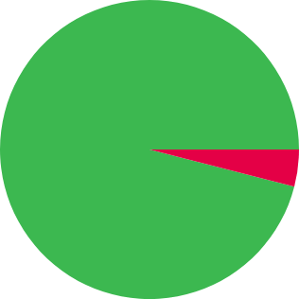
Milestones
24 Passed
96% set to Passed
96%
passed
0 Blocked
0% set to Blocked
0 Retest
0% set to Retest
0 / 25 untested (0%).
1 Failed
4% set to Failed
The chart displays the aggregated statistics for all open milestones.
Open
March 2022
SP2 Batch12
96%

Slide 3
Test Runs & Plans
24 Passed
96% set to Passed
96%
passed
0 Blocked
0% set to Blocked
0 Retest
0% set to Retest
0 / 25 untested (0%).
1 Failed
4% set to Failed
The chart displays the aggregated statistics for all open test runs & plans.
Open
Tuesday, March 15, 2022
SP2 Robot Framewoek Result
SP2 Batch12
96%

Slide 4
History
Tuesday, March 15, 2022
Test Run
SP2 Robot Framewoek Result
Created by Fanny Restu A.

Slide 5
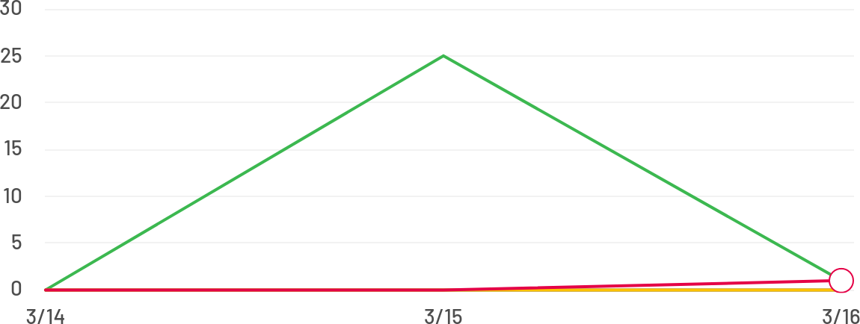
Activity
3/14/2022 – 3/16/2022:
26 Passed
96% set to Passed
0 Blocked
0% set to Blocked
0 Retest
0% set to Retest
1 Failed
4% set to Failed
Wednesday, March 16, 2022
Failed
TC_PamentByPaypal
Tested by Fanny Restu A.
Passed TC_Logout
Tuesday, March 15, 2022
Tested by Fanny Restu A.
Passed
TC_ChangePayment
Tested by Fanny Restu A.
Passed
TC_PaymentWithBank
Tested by Fanny Restu A.
Passed
TC_RemoveOrderAndverify
Tested by Fanny Restu A.
Passed
TC_VerifySummaryOrder
Tested by Fanny Restu A.
Passed
TC_AddToCart
Tested by Fanny Restu A.

Slide 6
Passed
TC_ClearFilter
Tested by Fanny Restu A.
Passed
TC_FilterGuestRating
Tested by Fanny Restu A.
Passed
TC_SortByPrice
Tested by Fanny Restu A.
Passed
TC_ButtonMinusQty
Tested by Fanny Restu A.
Passed
TC_ButtonAddedQty
Tested by Fanny Restu A.
Passed
TC_SearchNowTheHotel
Tested by Fanny Restu A.
Passed
TC_InvalidRegister
Tested by Fanny Restu A.
Passed
TC_ValidChangePassword
Tested by Fanny Restu A.
Passed
TC_InvalidChangePassword
Tested by Fanny Restu A.
Passed
TC_ValidAddress
Tested by Fanny Restu A.
Passed
TC_InvalidAddress
Tested by Fanny Restu A.
Passed
TC_ValidAddress
Tested by Fanny Restu A.
Passed
TC_InvalidAddress2
Tested by Fanny Restu A.
Passed
TC_InvalidAddress
Tested by Fanny Restu A.
Passed
TC_InvalidEmail
Tested by Fanny Restu A.
Passed
TC_InvalidPassword
Tested by Fanny Restu A.
Passed
TC_NormalLogin
Tested by Fanny Restu A.
Passed
TC_Invalid Register
Tested by Fanny Restu A.

Slide 7
Passed
TC_Register
Tested by Fanny Restu A.
Passed
TC_NavigateToUrl
Tested by Fanny Restu A.
Untested
TC_NavigateToUrl
Generated with TestRail test management software – 7.4.1.9005
Report: Project (Summary), by Gurock Software (Version 1)

